Slide 1
CS Classroom
Kashob Kumar Roy, Roll: 01
Md. Musfiqur Rahman, Roll: 05
Syeed Abrar Zaoad, Roll: 23
Mashrur Rashik, Roll: 29
Md. Tanvir Alam, Roll: 61

Slide 2
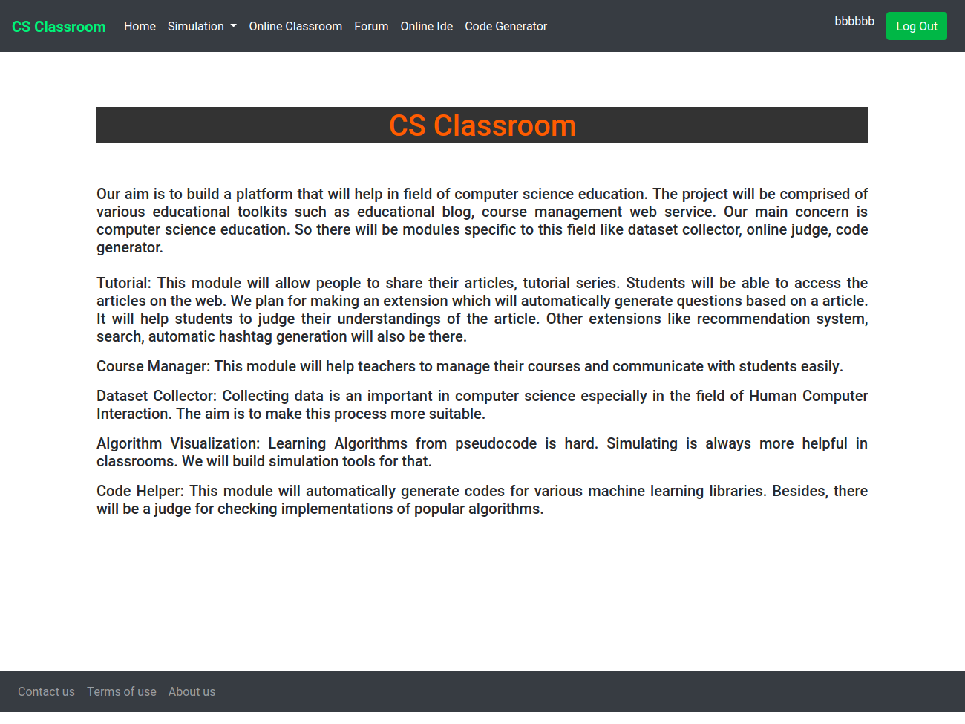
Introduction
Classroom web application
Specifically for computer science students
Scope:
Algorithm Simulation
Classroom
Forum
Ide
Code generator

Slide 3
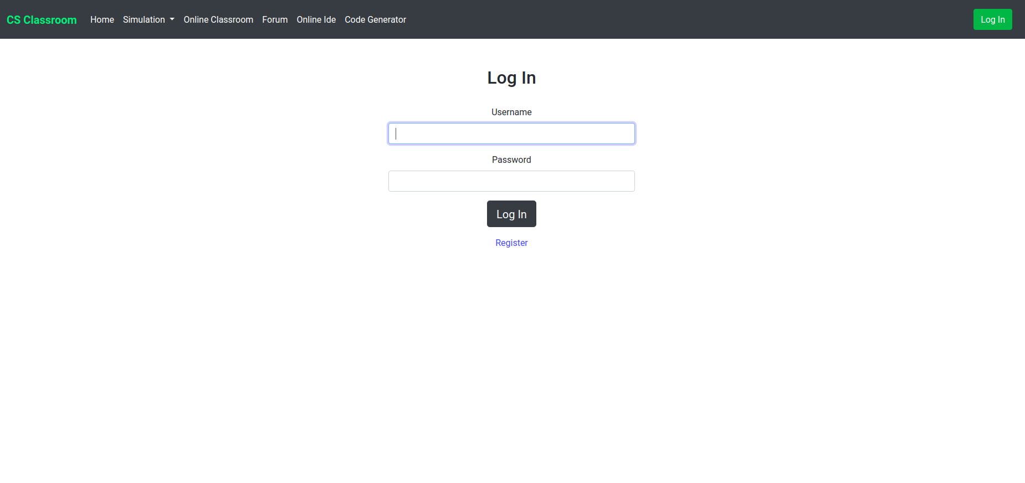
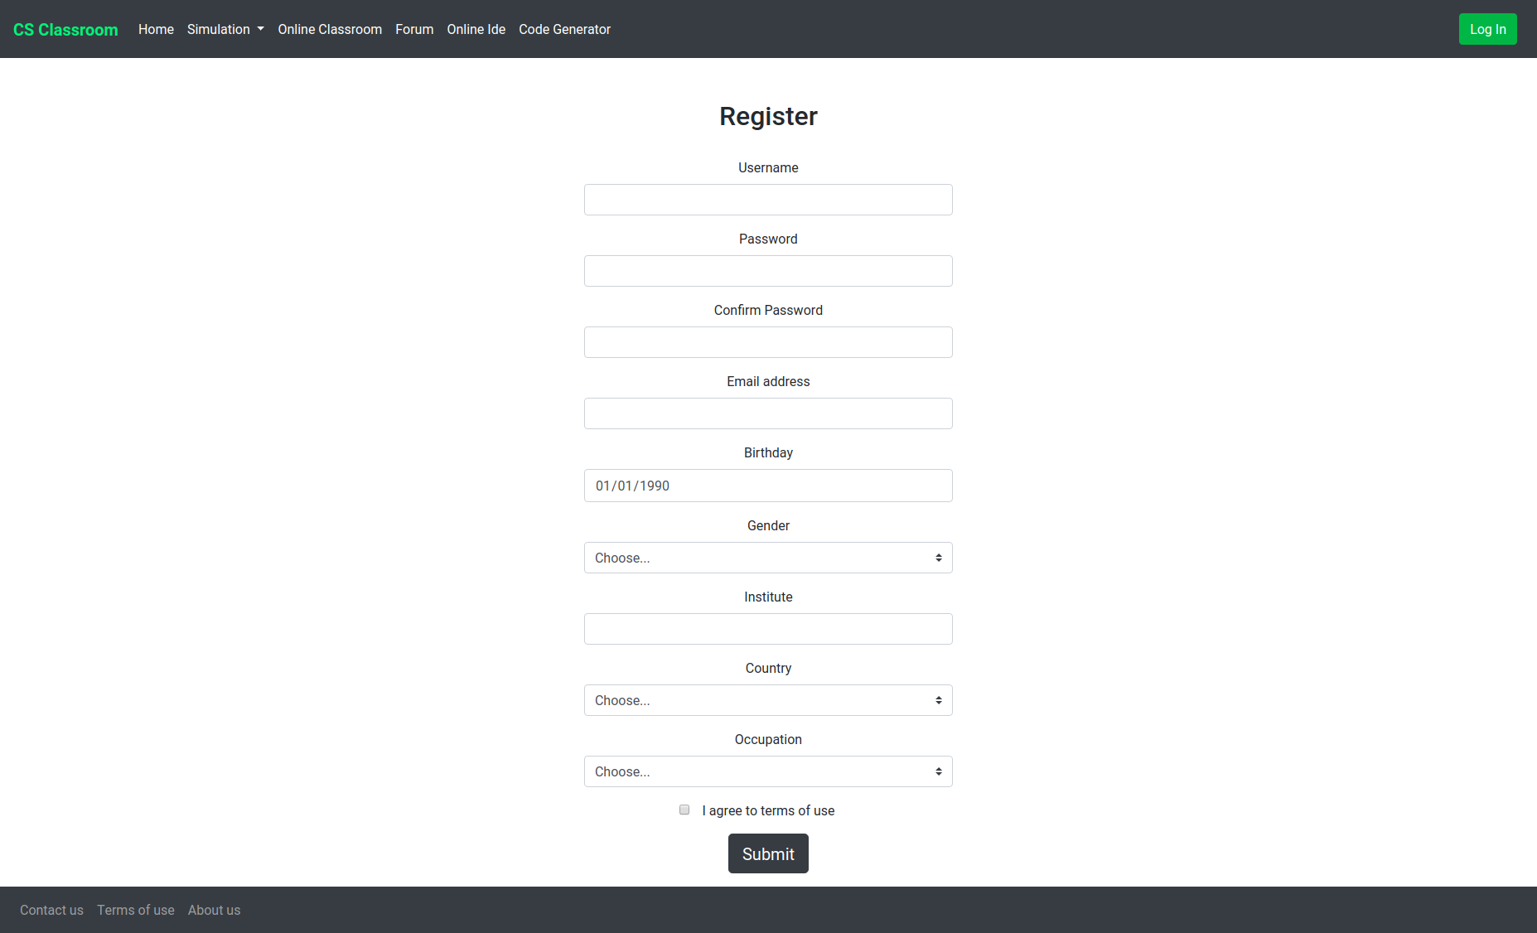
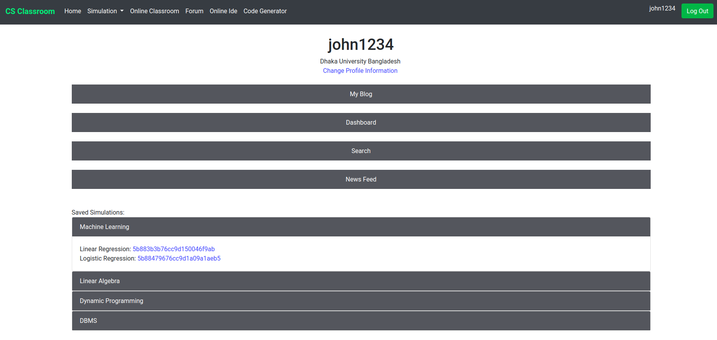
User Login & Registration
User login and registration implemented using database
User profile present to view saved simulations and dashboard
Flask session manager used to handle user session

Slide 4
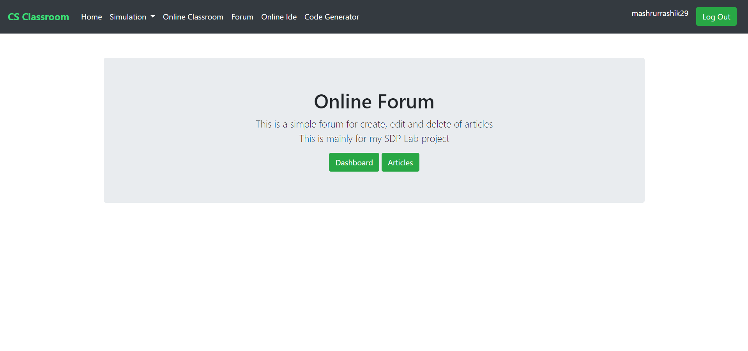
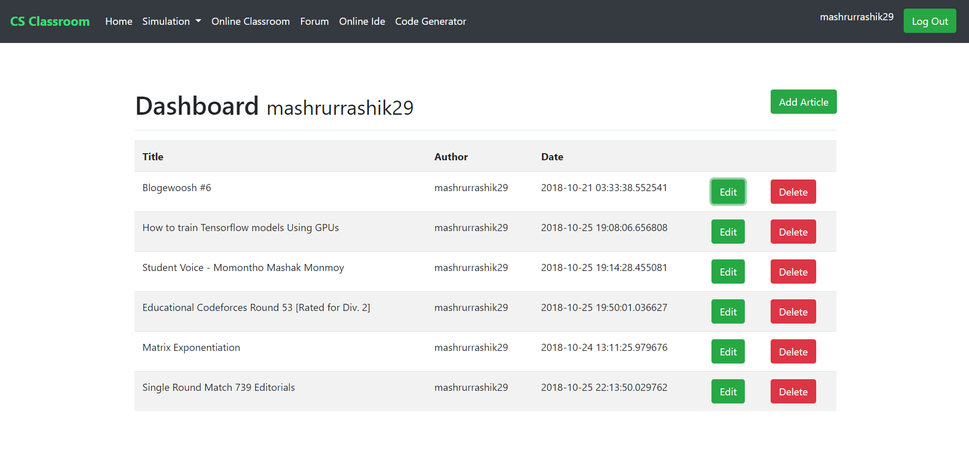
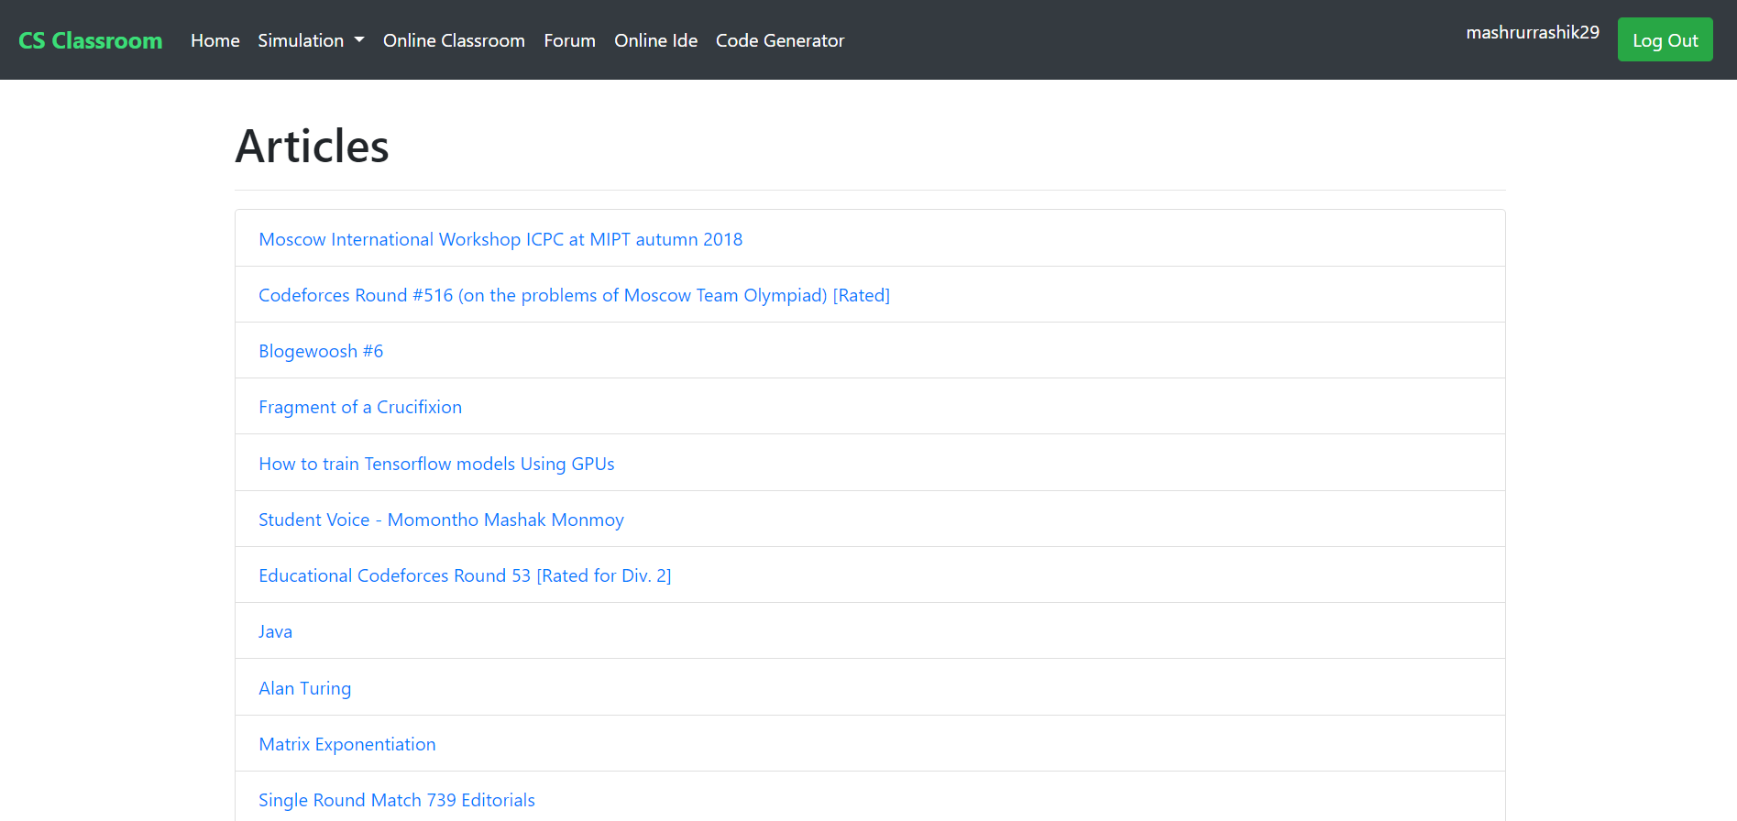
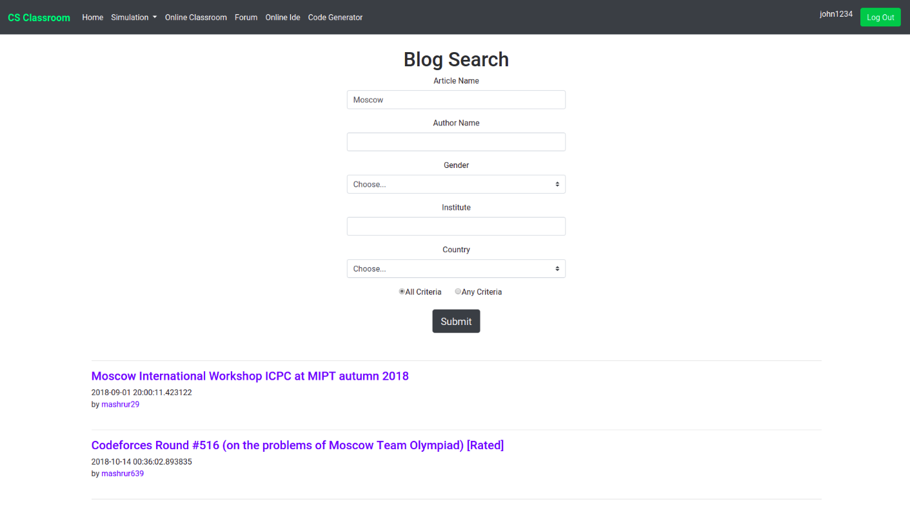
Forum
Online forum to post articles of certain interest
User dashboard for edit and delete of articles
Blog search

Slide 5
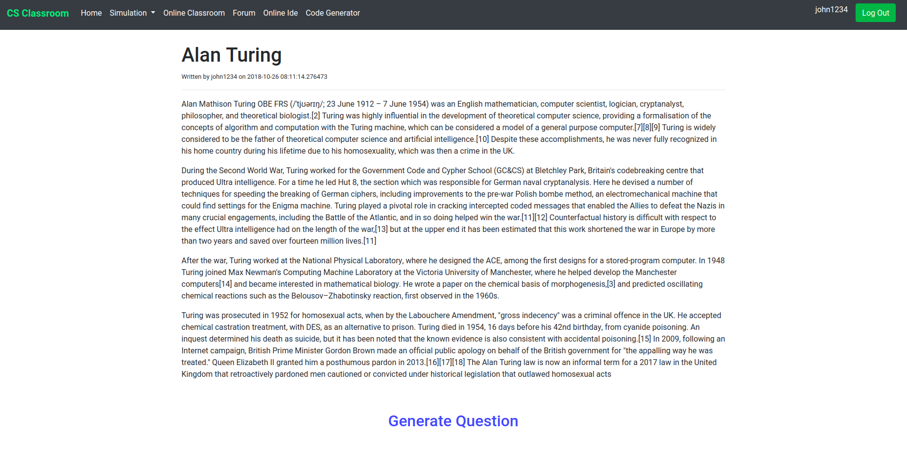
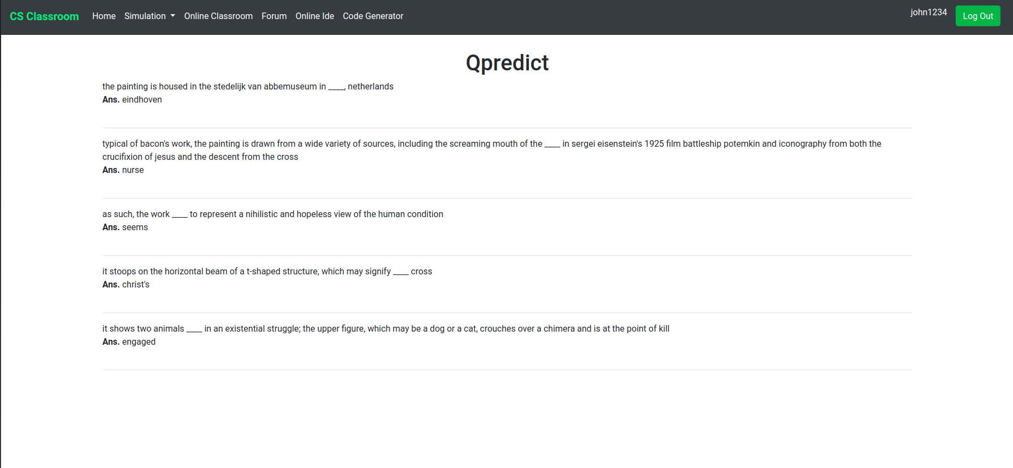
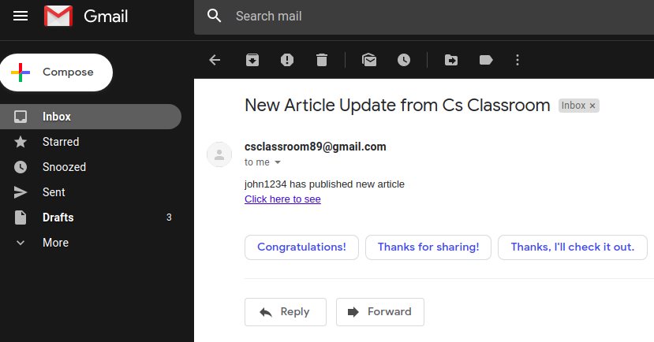
Question Predict from Forum Article & Email Notification
Question generation from blog posts
Question generated provides self evaluation on certain topic
Email notification to notify users subscribed to the blogger

Slide 6
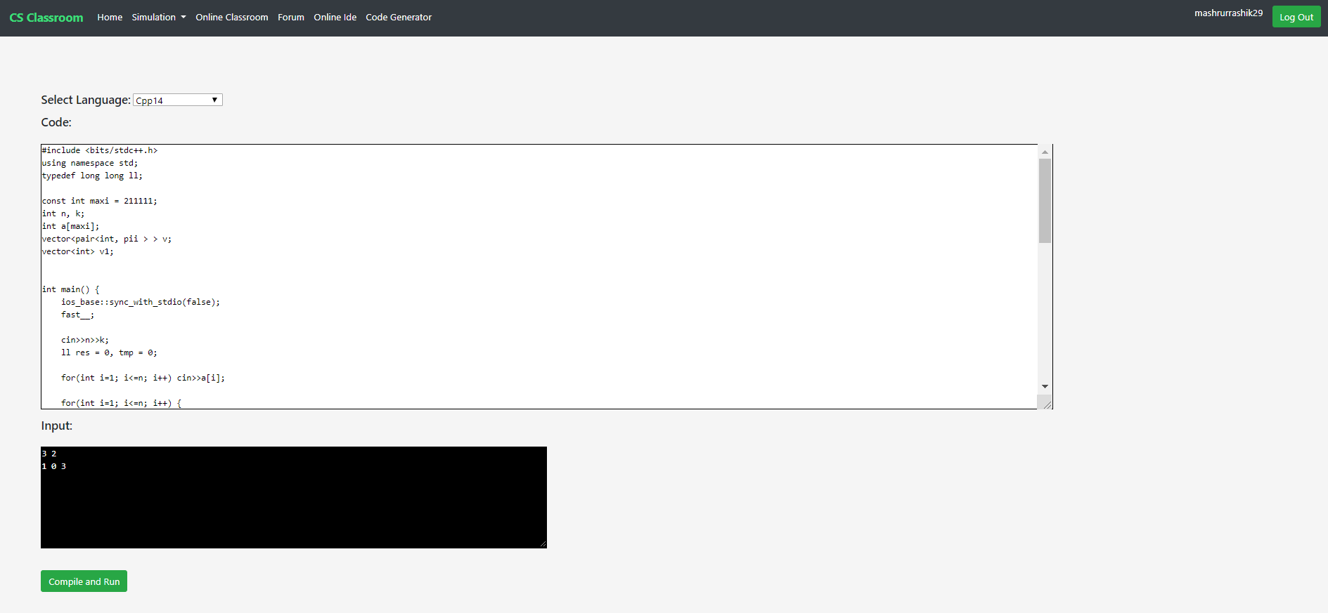
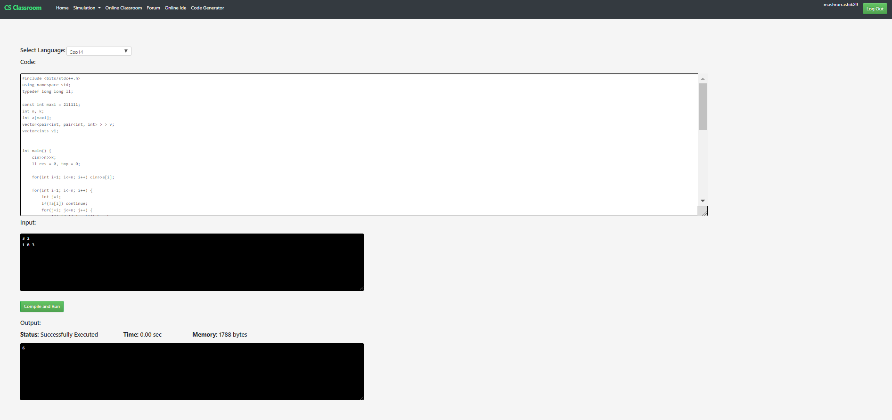
Online Code Editor
Online code editor with multiple language support
Input textarea for input data
Output textarea with code generated output along with memory used and time of execution

Slide 7
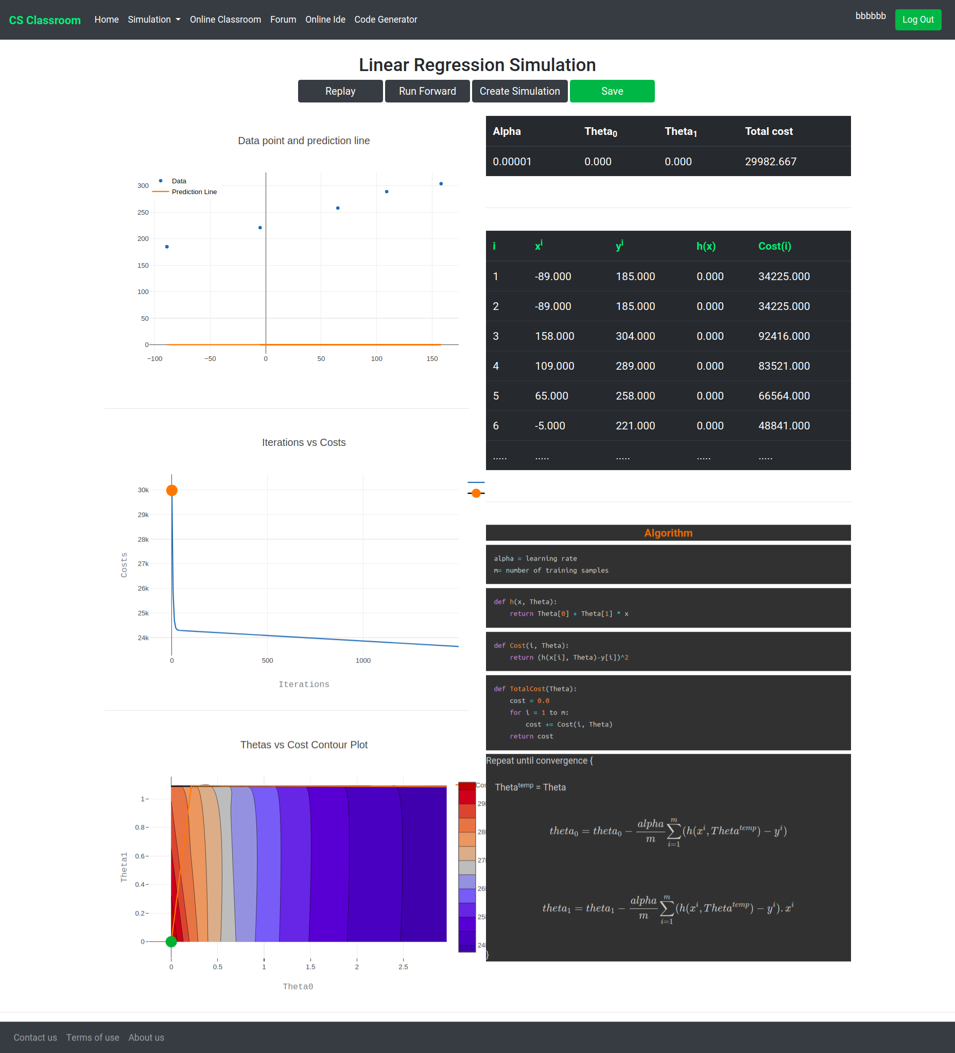
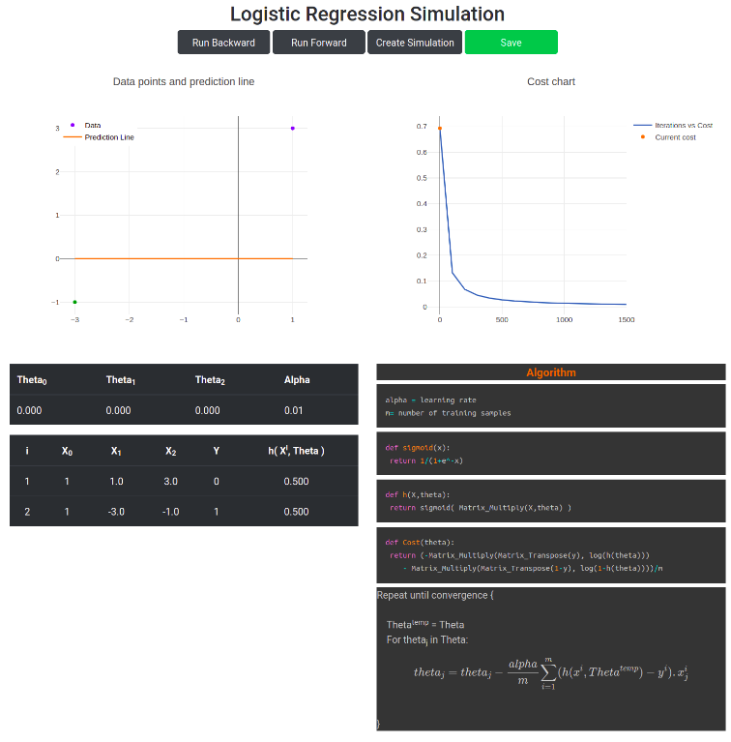
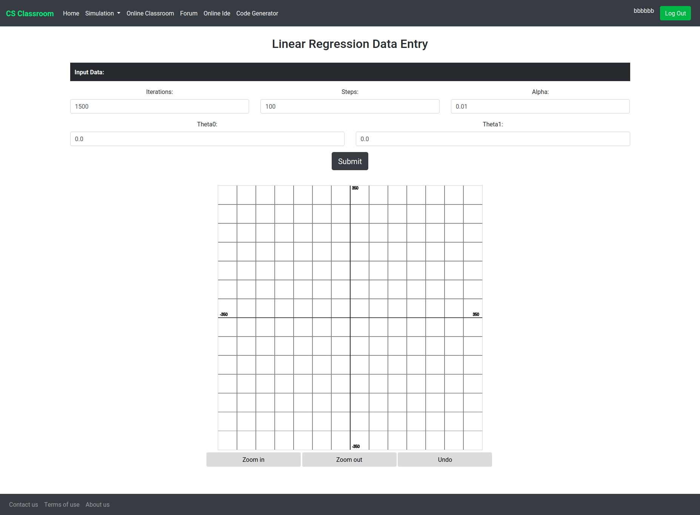
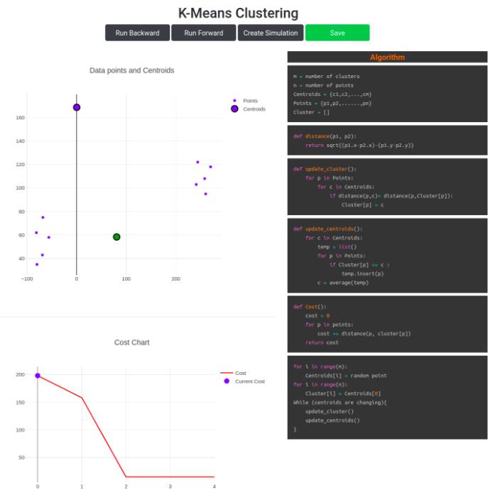
Machine Learning Algorithm Simulation
Machine learning algorithm simulation with necessary charts
Includes two unsupervised learning algorithms and one supervised learning algorithm
Charts provided along with pseudocode highlighting
Implemented graph input module for creating custom simulation

Slide 8
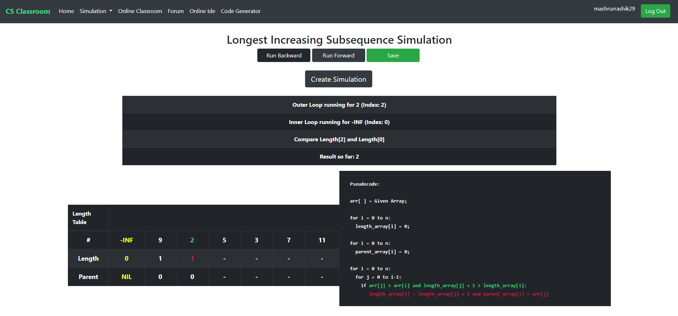
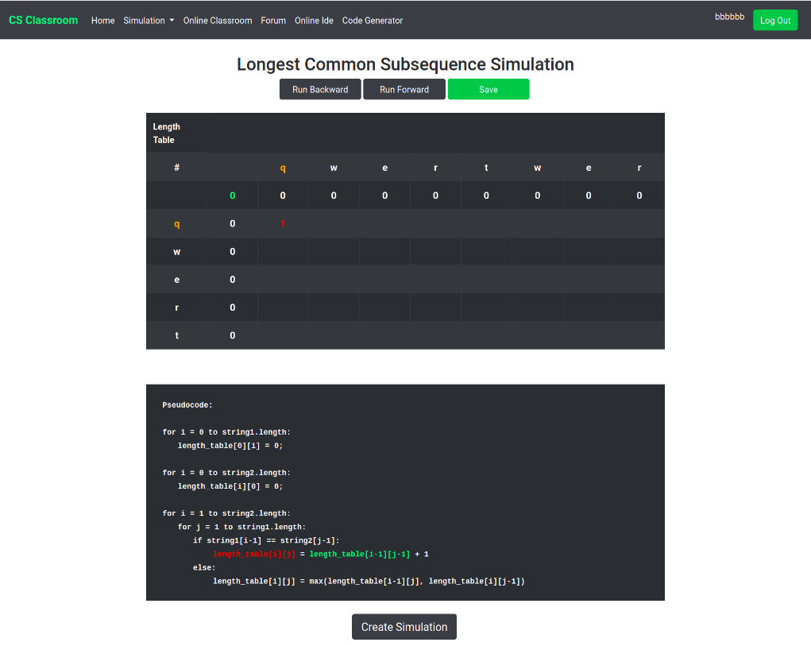
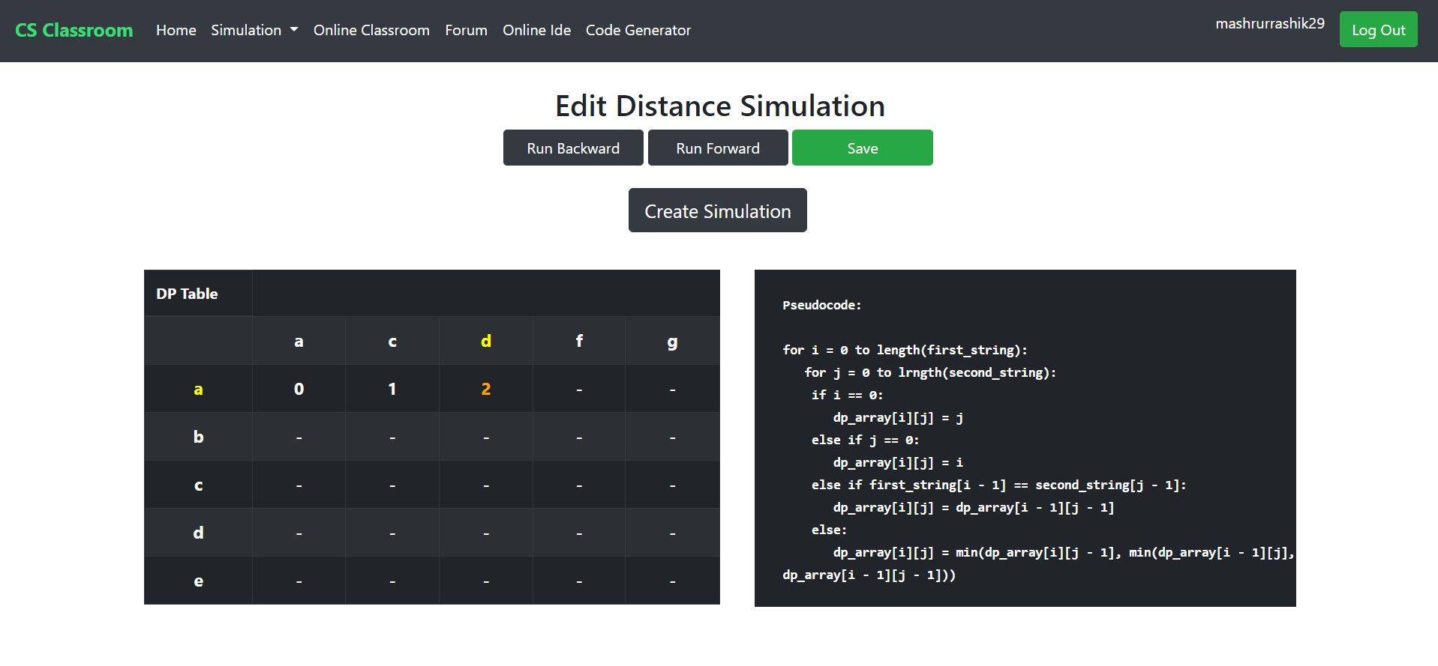
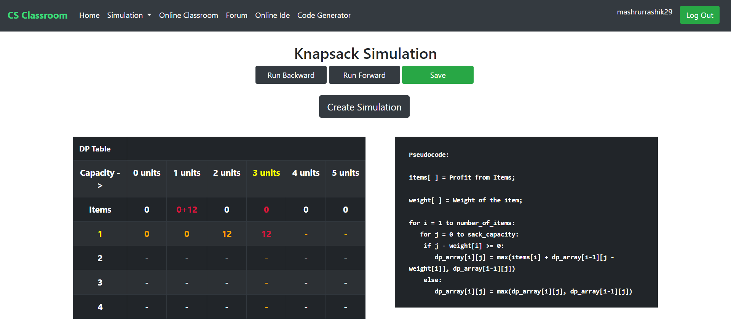
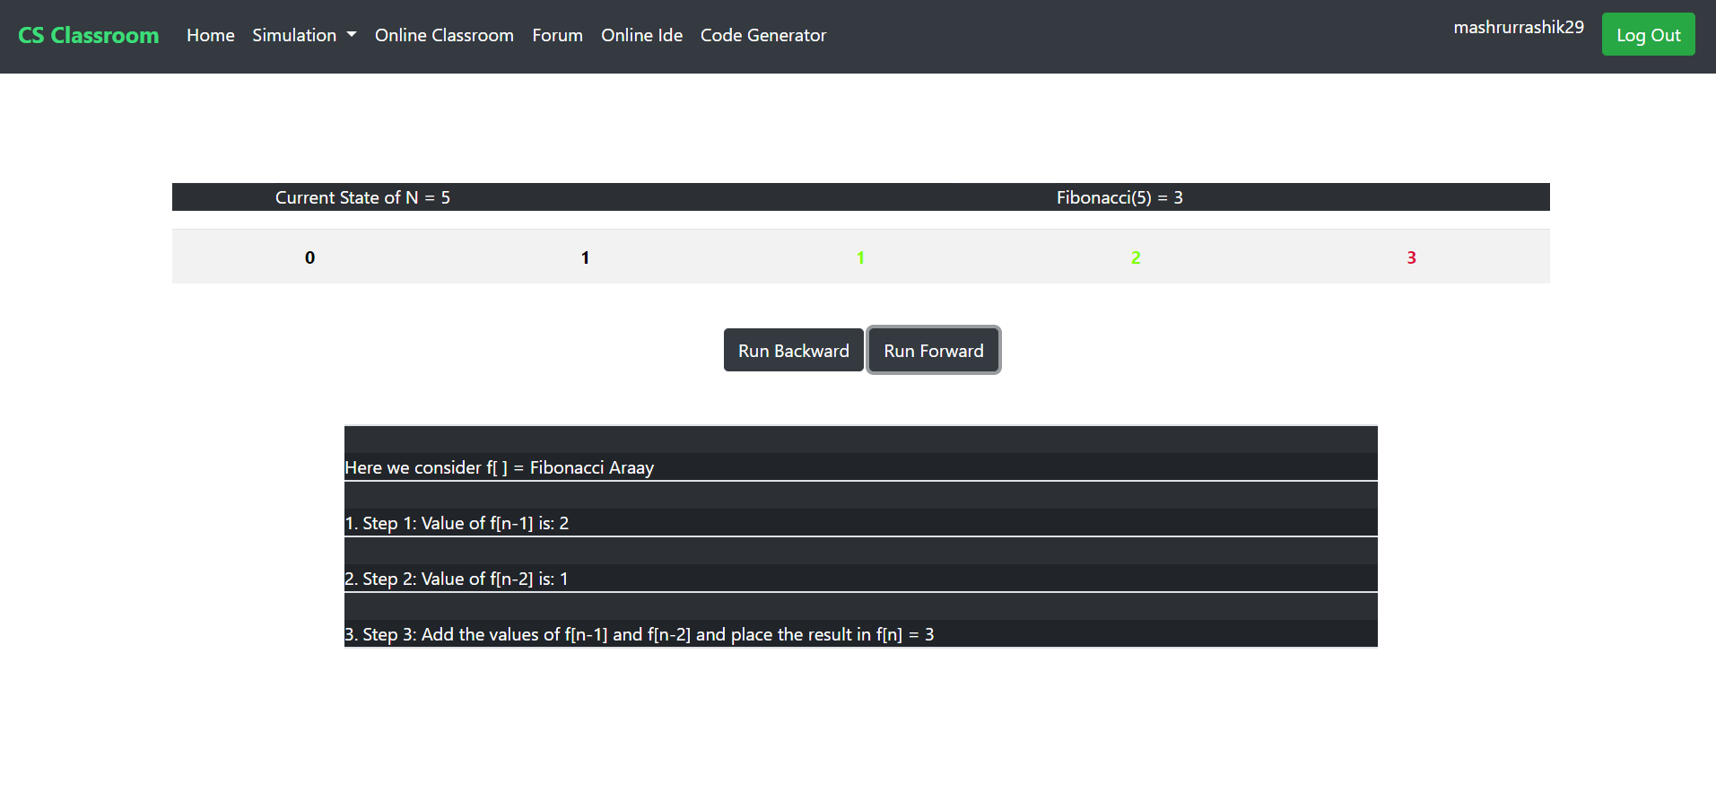
Iterative Dynamic Programming Simulation
Simulation easier than pseudocode for dynamic programming
Can generate output based on user input
Nine different iterative algorithms
Includes pseudocode highlighting for better understanding of current execution

Slide 9
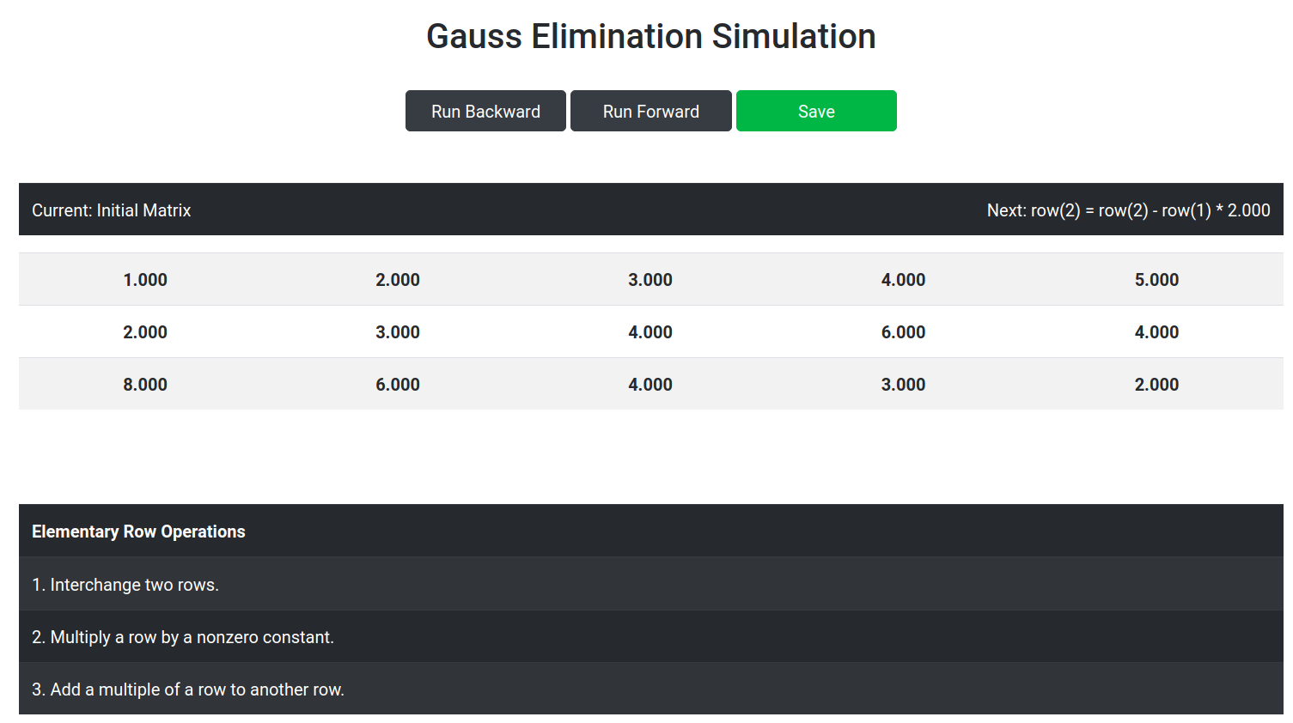
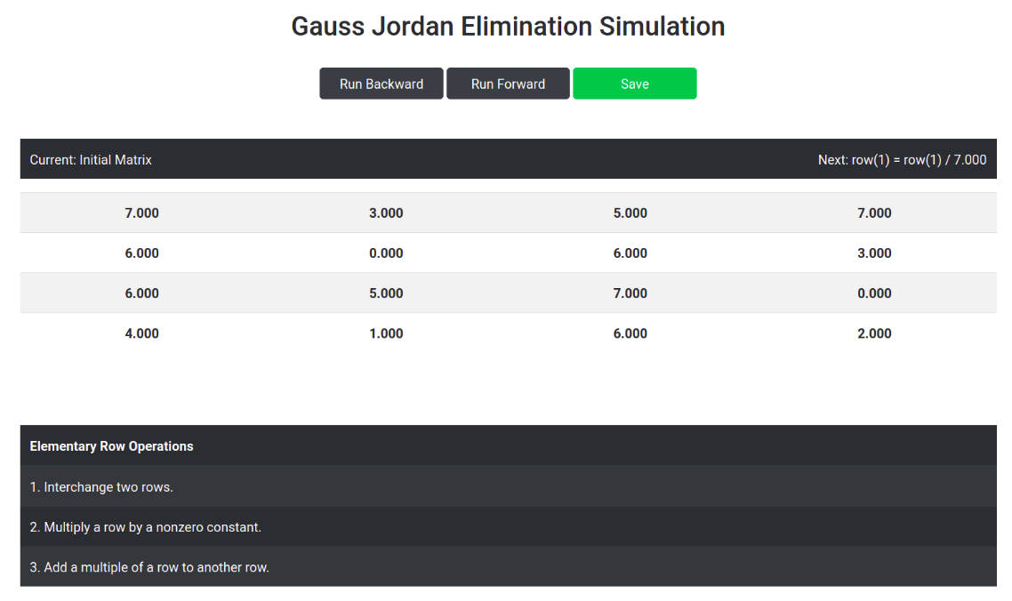
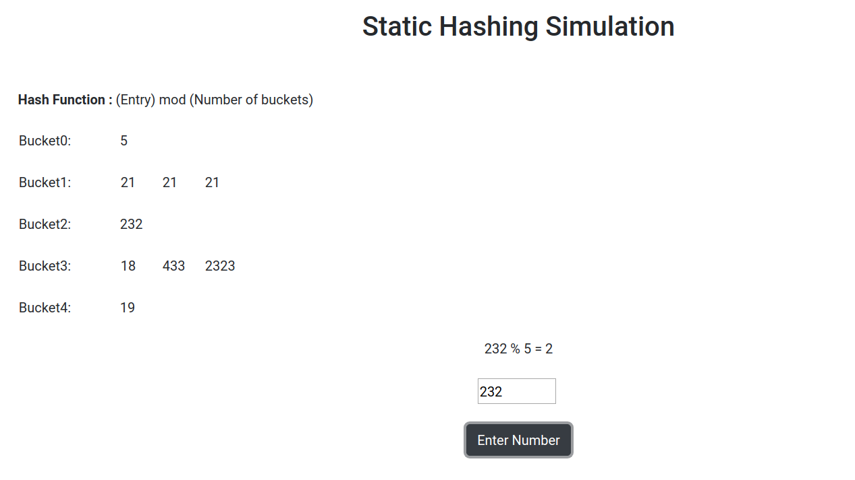
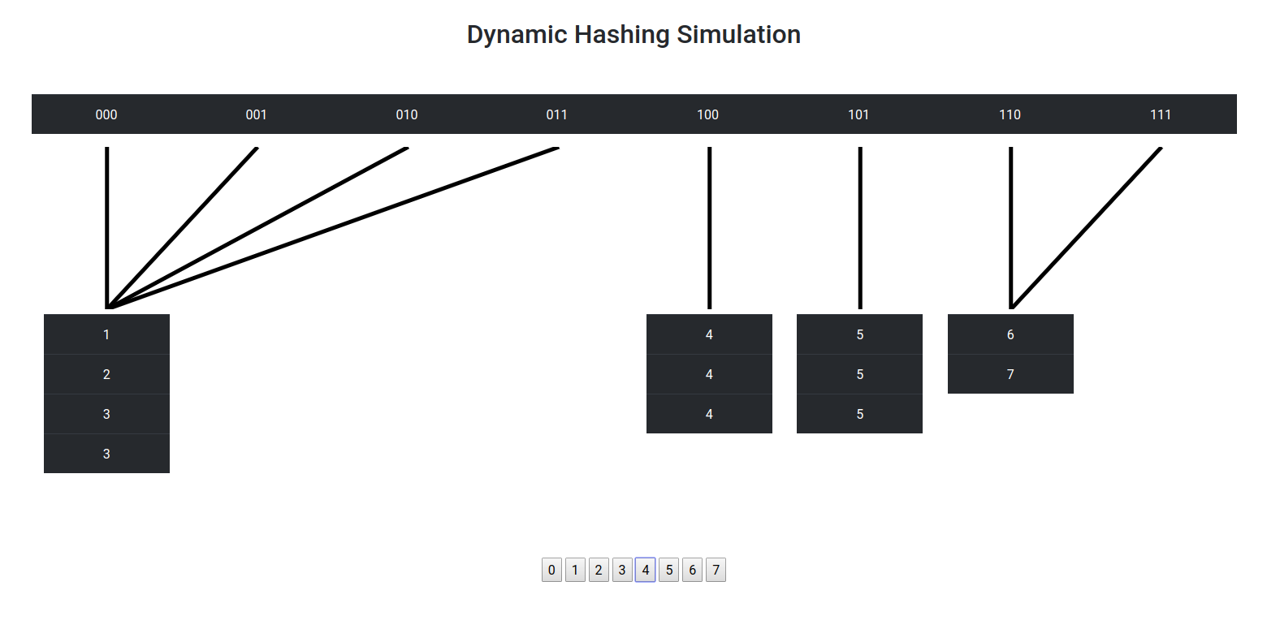
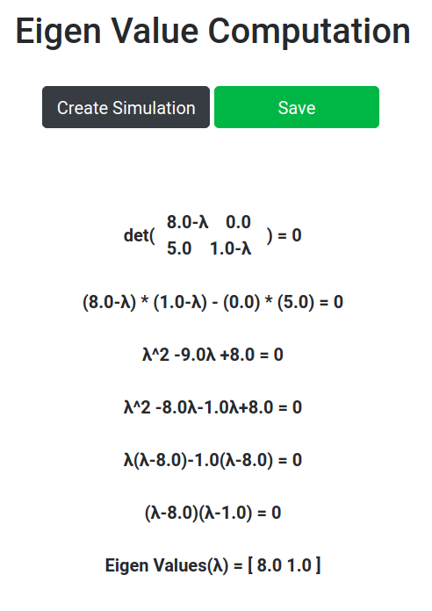
Linear Algebra, DBMS Algorithm Simulation
Gaussian elimination simulation along with eigen value computation
Simulation of static and dynamic hashing
Proper diagram to represent dynamic hashing

Slide 10
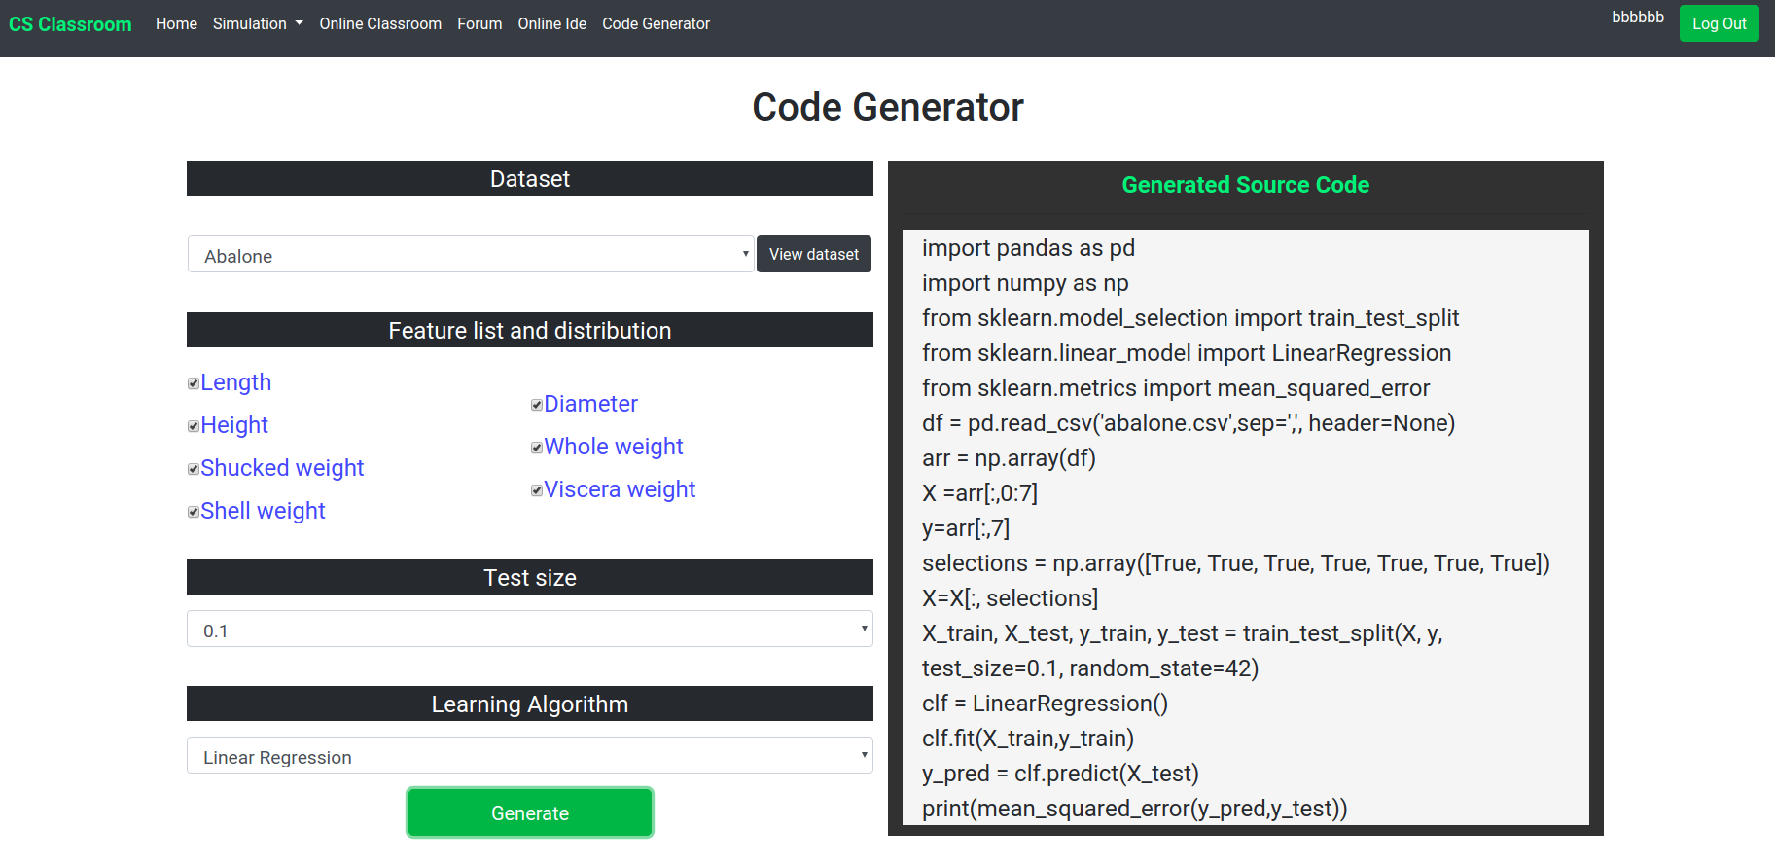
Code Generator
Code generator for user specified dataset
Output code uses scikit learn library
Multiple dataset for user selection

Slide 11
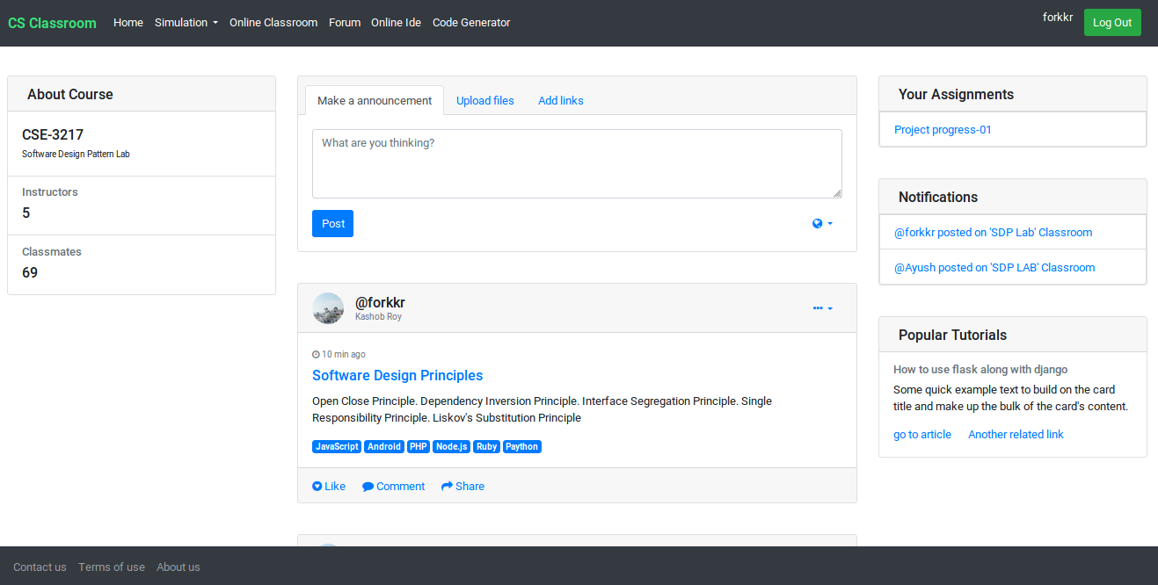
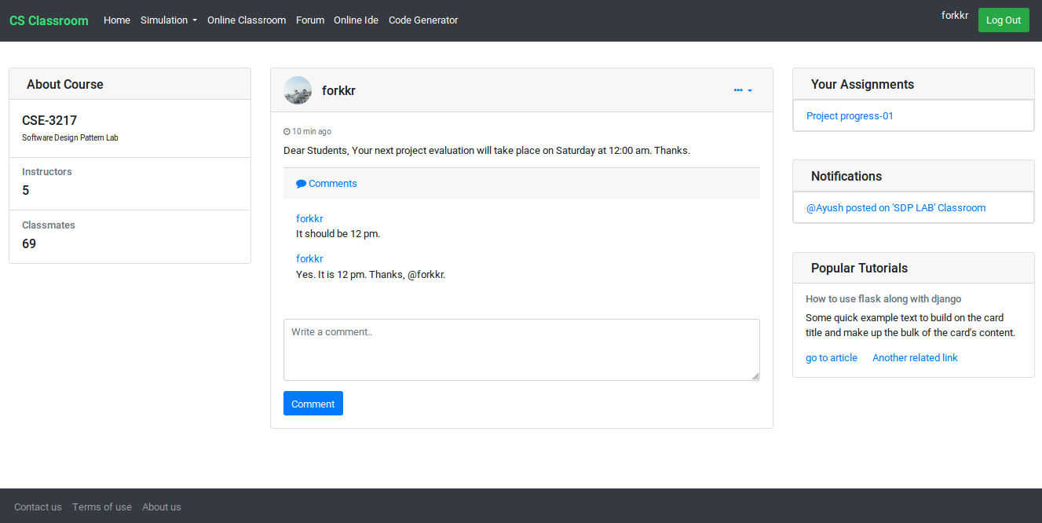
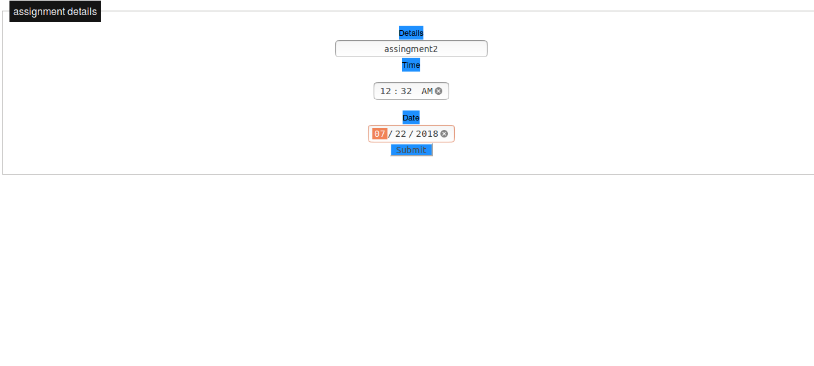
Online Classroom
An educational social platform
To share ideas and knowledges
To share files between teachers and students
To create , distributing and evaluating assignments
To suggest related articles

Slide 12
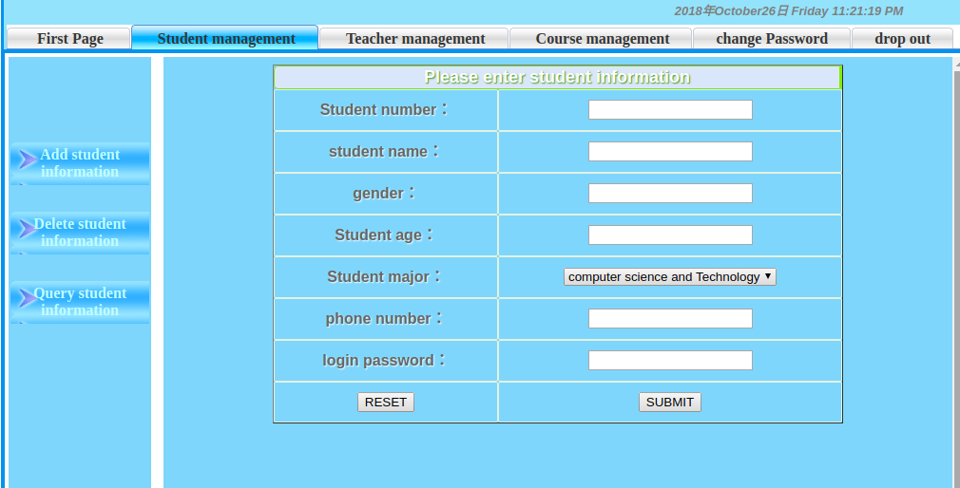
Teacher Student Management
Decorator pattern helps admin to perform management of students, teachers and courses.
All information about the classroom are accessible to the admin.

Slide 13
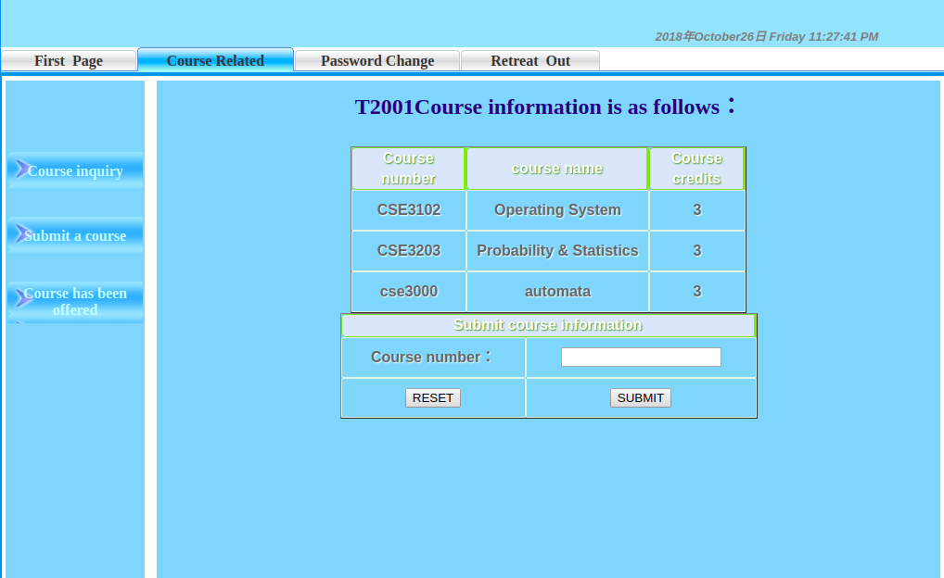
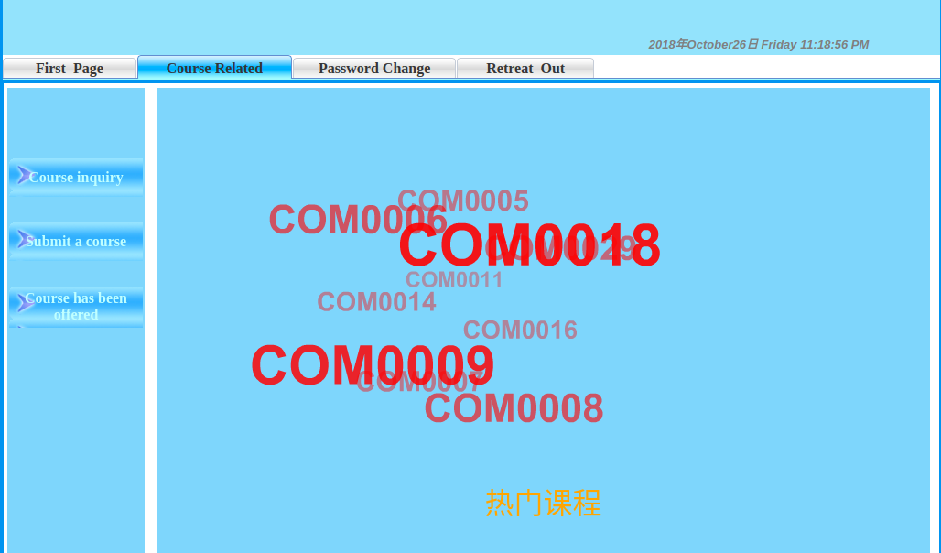
Teacher Student Management
Teachers have ability to join any course.
Any student can request to enroll himself in preferred courses.
Adapter pattern helps the system to notify the admin about new enrollment requests.
Gives a visual representation of queries about courses, teachers and students.

Slide 14
Design Patterns Currently Used
Design Pattern | Frequency
Singleton Pattern | 2
Strategy Pattern | 4
Abstract Factory Pattern | 1
Observer Pattern | 3
Filter Pattern | 1
Decorator Pattern | 2
Total | 13

Slide 15
Thank You

